Slide 1
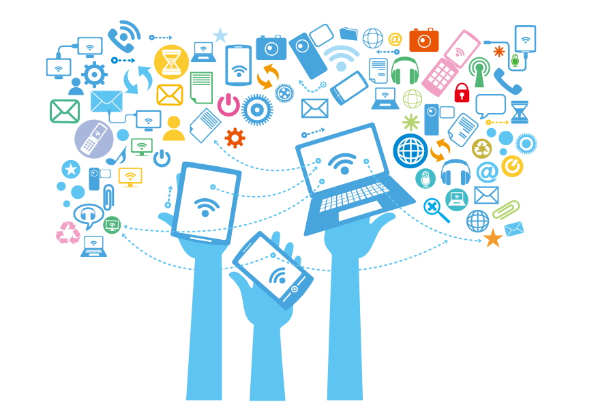
Media and Internet
Ravi Prakash sahu
Id= 31740

Slide 2
THE INTERNET
WHAT?
The internet is a global system of interconnected computer networrks that use the standard(tcp/ip) to serve services.
Popular opreating software:
internet explorer
google chrome

Slide 3
THE INTERNET
Advantages:
Communication: E.g. Google Gtalk, Yahoo Messenger, etc.
Information: E.g. Google, Yahoo, Microsoft’s Bing, etc.
Entertainment: E.g. Online Games, ps box, spotify, etc.
Services: E.g. Online nett banking, Job searching, etc.
E-Commerce: E.g. Flipkart, Meso(sahi sahi lagao), ebay, etc.

Slide 4
THE INTERNET
Disadvantages:
Theft of Personal Information
Spamming
Virus threat
Reducing of actual physical contact between amongs
Cyber slacking

Slide 5

media
What?
Newspapers, magazines, television and any other channel of information.
One of the fastest growing sectors in india, might grow faster than G.D.P.
Media and Entertainment industry is one of the most flurishing sectors in india.

Slide 6

RAVI PRAKASH SAHU 31740

